Slide 1



credit_card_report
View in Power BI
Last data refresh:
11-08-2024 17:47:27 UTC
Downloaded at:
11-08-2024 17:50:23 UTC

Slide 2
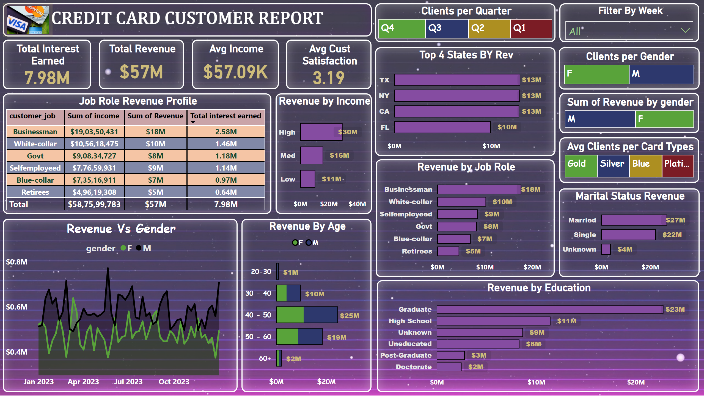
CC Customer
Notes:
Avg Income
No alt text provided
Clients per Gender
No alt text provided
Total Revenue
No alt text provided
Avg Cust Satisfaction
No alt text provided
Total Interest Earned
No alt text provided
Clients per Quarter
No alt text provided
Job Role Revenue Profile
No alt text provided
Revenue by Income
No alt text provided
Avg Clients per Card Types
No alt text provided
textbox
No alt text provided
Filter By Week
No alt text provided
Revenue Vs Gender
No alt text provided
treemap
No alt text provided
Revenue By Age
No alt text provided
Revenue by Job Role
No alt text provided
Revenue by Education
No alt text provided
Top 4 States BY Rev
No alt text provided
Marital Status Revenue
No alt text provided
image
No alt text provided

Slide 3
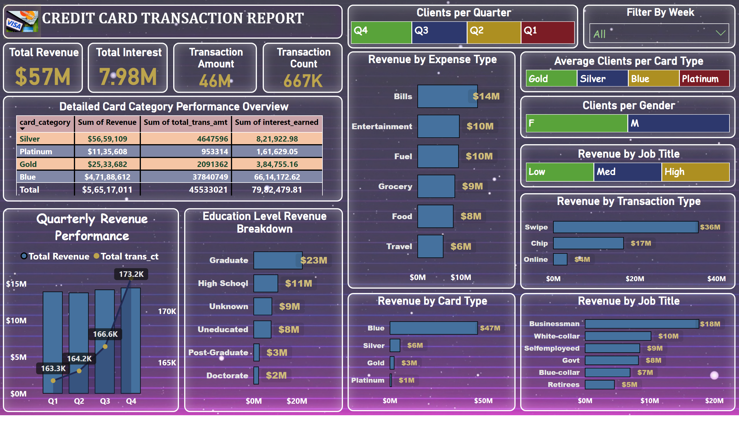
CC Transaction
Notes:
textbox
No alt text provided
Quarterly Revenue Performance
No alt text provided
Revenue by Expense Type
No alt text provided
Education Level Revenue Breakdown
No alt text provided
Revenue by Job Title
No alt text provided
Revenue by Card Type
No alt text provided
Revenue by Transaction Type
No alt text provided
Detailed Card Category Performance Overview
No alt text provided
Total Revenue
No alt text provided
Transaction Amount
No alt text provided
Total Interest
No alt text provided
Transaction Count
No alt text provided
Filter By Week
No alt text provided
Clients per Gender
No alt text provided
Clients per Quarter
No alt text provided
Average Clients per Card Type
No alt text provided
Revenue by Job Title
No alt text provided
image
No alt text provided

